Slide 1
ECE 593 – Fundamentals of Pre-Silicon Validation – Team 12 Project Presentation
By Badhrinadh Alladurgam
Megha Sai Amith Reddy Mukku
Rama Krishna Reddy Gopavarapu
Risheek Bharadhwaj

Slide 2
Team Introduction
Badhrinadh Alladurgam
3rd Quarter @ PSU
Did 2 SystemVerilog Projects in the Previous Terms
Megha Sai Amith Reddy Mukku
3rd Quarter @ PSU
Did 2 SystemVerilog Projects in the Previous Terms

Slide 3
Team Introduction
Rama Krishna Reddy Gopavarapu
3rd Quarter @PSU.
Did 2 System Verilog projects in Previous Term.
Risheek Bharadhwaj
3rd Quarter @PSU.
Did 2 System Verilog projects in Previous Term.

Slide 4
Member Participation
Badhrinadh Alladurgam
fifo_mem
Coverage_uvm
driver
top_uvm
Megha Sai Amith Reddy Mukku
readptr
writeptr
uvmtest
sequence_fifo_wr

Slide 5
Member Participation
Rama Krishna Reddy Gopavarapu
scoreboard
r2wsync
w2rsync
Sequencer
agent
Risheek Bharadhwaj
monitor
interface
env
top
Fifo_seq_item

Slide 6
Project Description
An asynchronous FIFO (First-In-First-Out) is a digital circuit used in digital electronics to manage the flow of data between two asynchronous systems. It acts as a buffer, temporarily storing data when the rate at which data is being produced is different from the rate at which it is consumed. Asynchronous FIFOs are commonly used in communication interfaces between different clock domains or between systems with different operating frequencies.
Some of the applications of Asynchronous FIFO include
Memory interfaces
Network Packet Switching
Digital Signal Processing etc.,
As per the design specifications provided the FIFO was designed with the assumption that the Sender works at 250 MHz and the receiver at 100 MHz, ensuring that data is given and consumed at distinct rates.

Slide 7
Project Description
As per the group specifications specified our group is “J”
Sender Clock Frequency / Writing Frequency = 250Mhz. Receiver Clock Frequency / Reading Frequency = 100Mhz. Write Idle Cycles = 1. Read Idle Cycles = 3.
Write Cycles:
The number of idle cycles between 2 successive writes is 1 which means after writing one data the next one is initiated after waiting for 1 clock cycle.
For every 2 clock cycles 1 data is written. Time required to write one data item = 2 * 1/250Mhz = 2 * 4 nano sec. Time required to write one data item = 8 nano seconds.
Read Cycles:
The number of idle cycles between 2 successive reads is 3 which means after reading one data the next one is initiated after waiting for 3 clock cycles.
For every 4 clock cycles 1 data is read.
Time required to read one data item = 4 * 1/100Mhz = 4 * 10 nano sec Time required to read one data item = 40 nano seconds. As per the given data the total burst of data is = 200. So at a time the total number of writes that can be done is = 200.
Time taken to write all the 200 burst of data = 200 * 8 = 1600 nano seconds. Total number of reads that can be done in 1600 nano seconds = 1600/40 = 40 reads.
Remaining data items to be read = 200 – 40 = 160. The minimum depth of FIFO is = 160. The depth of FIFO specified for the minimum requirements (i.e., 160) in this project is 256.

Slide 8
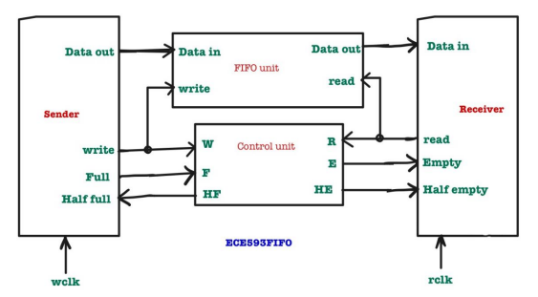
Block Diagram

Slide 9
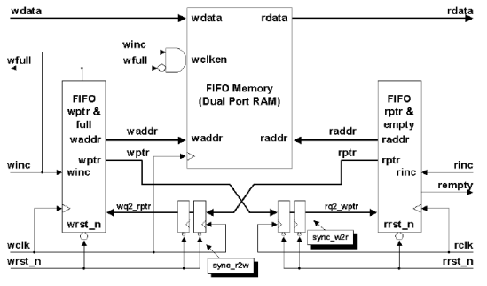
FIFO Partitioning with Synchronized Pointer Comparison

Slide 10
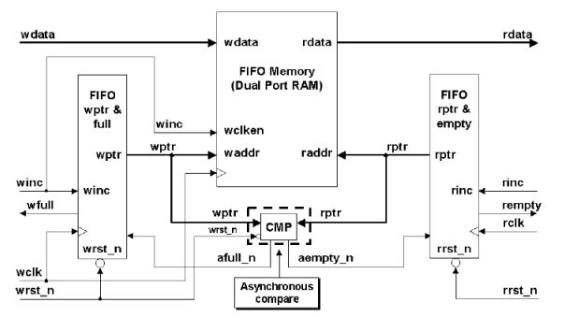
FIFO Partitioning With Asynchronous Pointer Comparison Logic

Slide 11
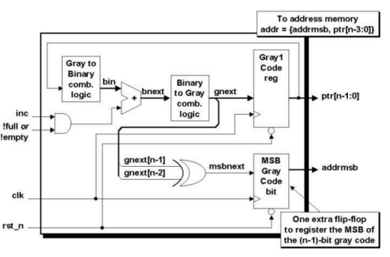
Dual n-bit Gray Code Counter Block Diagram

Slide 12
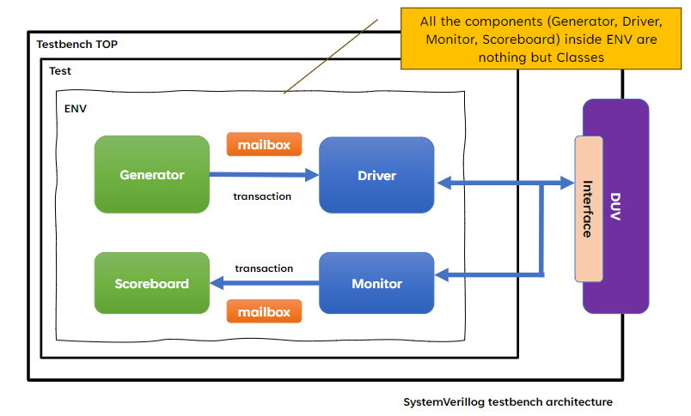
Class Based Test Bench Architecture

Slide 13
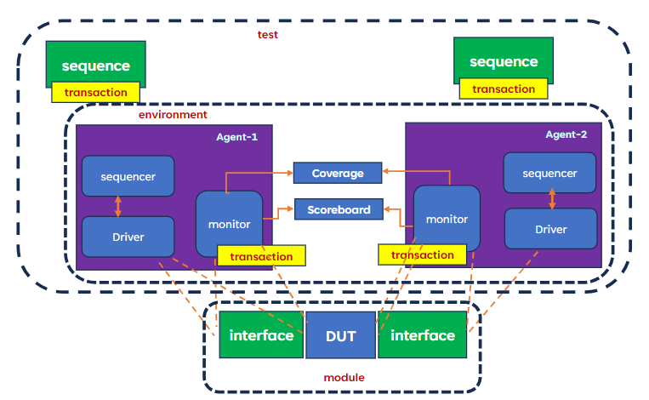
UVM Test Bench Architecture

Slide 14
Coverage Metrics
# TOTAL COVERGROUP COVERAGE: 91.28% COVERGROUP TYPES: 3
# Total Coverage By Instance (filtered view): 91.28%

Slide 15
Challenges Faced
Implementing the correct depth in the design without any errors took us few iterations.
Faced challenges in maintaining data integrity during read and write operations.
Ensuring accurate conditions for Half full, Half empty and Full and Empty conditions.
Verifying the functionality and correctness of the design using class based and UVM based testbench architectures.
Through out the project buildup we started our coverage metrics at 70% and we improved it to 91%.

Slide 16
Learning Outcomes
Learned how to build UVM based environment to verify.
Understood how a class based testbench environment works.
Understood the importance of asynchronous fifo.
Understood how reporting mechanisms work.
Understood TLM Connections.
Understood different phases and their application.

Slide 17
References:
All class lecture slides of Prof Venkatesh Patil.
https://vlsiverify.com/verilog/verilog-codes/asynchronous-fifo/
This link helped us to build RTL.
http://www.sunburst-design.com/papers/CummingsSNUG2002SJ_FIFO1.pdf
Gave the thorough understanding of asynchronous fifo.
https://github.com/raysalemi/uvmprimer
Helped us in building different components of UVM TB and Run.do
AI ChatBots(ChatGPT)
Gave us indepth understanding of the UVM Classes beyond UVM Primer.
Used as a goto option for all our doubts & questions.

Slide 18
Thanks for your time.

